Slide 1
Site selection
Notes:
In this chapter, we will discuss how to select a suitable stream site to monitor. This is an important step, because choosing a good site will ensure that you can safely collect water quality data year-round, that you enjoy your monitoring trips, and that your data can be used by agencies to accurately reflect water quality conditions on your stream.

Slide 2
Site selection
Choosing Your Site
Factors to Consider
Location Identification
Data Sheet Headers
Notes:
There are many factors to consider in choosing a monitoring site. We will discuss some of the most common reasons that volunteers choose a site, what factors to consider, and how to identify your site location and map your new site. Then, we will discuss the Site Selection form and how to get your biological monitoring equipment.

Slide 3
CHOOSING A SITE – HOW DO I DECIDE?
Notes:
First, we will discuss reasons for choosing a site to monitor.

Slide 4
Select a location of your choice
Learn the condition of a local stream
Favorite recreational stream
Pollution concerns
Priority for state agencies
Bridge a monitoring gap
Choosing Your Site
Factors to Consider
Location Identification
Data Sheet Headers
Notes:
These are some of the reasons that volunteers have chosen their particular stream sites to monitor. Many people are just interested in learning about the water quality of a stream that they live near or recreate on, but some folks have concerns about pollution in a particular stream and want to monitor for that reason.
Some folks want to contribute to science by monitoring a stream that is a priority for state agencies. Keep in mind that healthy streams are not often monitored by the agencies due to a limit of state resources, so many streams in Missouri have no water quality data recorded. Volunteer data is great baseline data for these streams.
You can contact your local MDC and DNR offices (MAPS ARE IN THE APPENDIX) and ask if they need water quality data on any local streams/have suggestions on where to monitor.

Slide 5
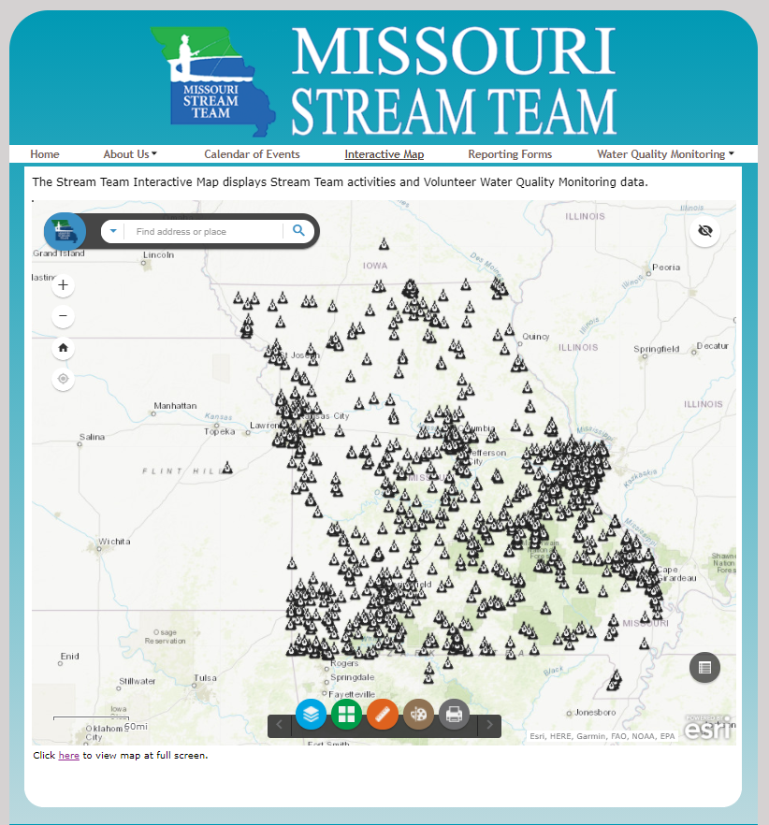
Find a Monitoring Gap
https://experience.arcgis.com/experience/ffacfa441aec4a9ca783c0a2b5691d93/?draft=true
Choosing Your Site
Factors to Consider
Location Identification
Data Sheet Headers
Notes:
You can find monitoring gaps by visiting the Interactive Map on the Stream Team homepage.
Accessed through ST homepage, interactive map tab
Contact other VWQM’s within your watershed
Look up local ST Associations (IN APPENDIX or contact ST staff)
Can contact Program Staff too.

Slide 6
Factors to consider
Notes:
Next, we will discuss some factors you will need to consider as you choose a stream site.

Slide 7
Ephemeral
Intermittent
Perennial
Stream Channel
Notes:
The groundwater table is at a different depth in different areas of the state, and groundwater also fluctuates seasonally.
Perennial streams are fed continuously by the shallow water table and have flow all year long.
Ephemeral streams exist above the water table. These streams lose water into the channel in a downstream direction.
Intermittent streams receive groundwater flow only part of the year; the flow stops when the water table drops below the channel.
Our sampling protocol is designed for perennial streams NOT intermittent or ephemeral streams.

Slide 8
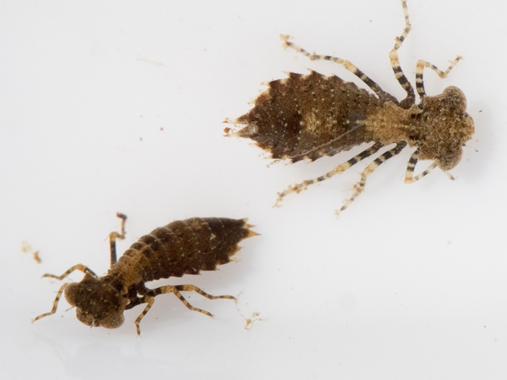
Flow requirement
Best sites have flowing water year-round
Site must maintain at least a pool during dry periods
ChoosingYour Site
Factors to Consider
Location Identification
Data Sheet Headers
Notes:
The best monitoring sites have flowing water all year long.
If part of your site dries up during the driest part of the year, you can still sample during the spring and fall as long as a portion of your stream maintains pools that support aquatic life.
But, if your site completely dries up at some point in the year, it won’t be a suitable place to sample.

Slide 9
Monitoring site
300 ft section with at least one riffle
Sites should not overlap
Notes:
Your monitoring site will be a 300 ft. long section of stream (100 yards), ideally containing at least one riffle.
It may be harder to find a riffle if you are in a prairie or lowland stream. If this is the case, choose an alternative habitat such as a root mat or slow water habitat (covered later today).

Slide 10
Riffle habitat
Notes:
A riffle is a portion of the stream characterized by a descent in the streambed and where the water is agitated by rocks and/or boulders.
The first riffle on the left may allow you to get all three invertebrate net sets in this one riffle.
The second on the right may allow for only one or two nets, so make sure you have enough riffles within your reach to accommodate for three invertebrate sampling sets
The best stream sites contain at least one riffle, but…riffles are not found in some regions or in streams that have been modified. Alternative habitats are found in the notebook.
For sand or mud bottomed streams that have been channelized, look for a site containing a root mat, woody debris and non-flow areas (discussed more later).

Slide 11
Important considerations
Goals
Suitable Habitat
Point & Non-point Sources
Tributaries & Roads
Notes:
These are some other important things to consider as you choose a stream site. Keep in mind your own goals for water quality monitoring, and choose a stream site based on what you are most interested in learning about. You will need to find a spot with suitable macroinvertebrate habitat, but you should also consider whether there are specific point and non-point pollution sources you’d like to monitor for, and what roads or tributaries may be influencing your stream site.

Slide 12
Monitoring site
Notes:
This is a drawing of a hypothetical monitoring site. As you can see, the monitoring site includes a 300-foot stretch of the stream, and the riparian zone extends 100 feet back from the edge of the water on each side. In this scenario, the monitor has chosen a monitoring site downstream from the confluence of two streams. They also have a riffle and rootwad habitat in the site to provide macroinvertebrate habitat.
Always use the same 300 ft. stretch. CONSISTENCY IS KEY!
This is in your notebook to refer to definitions.

Slide 13
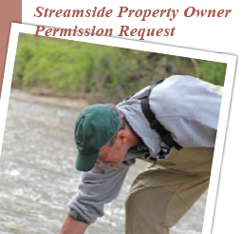
Site accessibility
Private Land
Public Land
Notes:
Ask permission for the whole 300ft of stream. You are BREAKING THE LAW if you fail to get permission.
You can monitor on public land if you ask permission from the area manager. For private land, you must ask the landowner for permission (we have a brochure available to help you start this conversation on the Stream Team website).
Be careful of the amount of monitoring in the area, because macroinvertebrate populations can be damaged if they are sampled too much! Managers should know if there are other volunteers monitoring on public land.

Slide 14
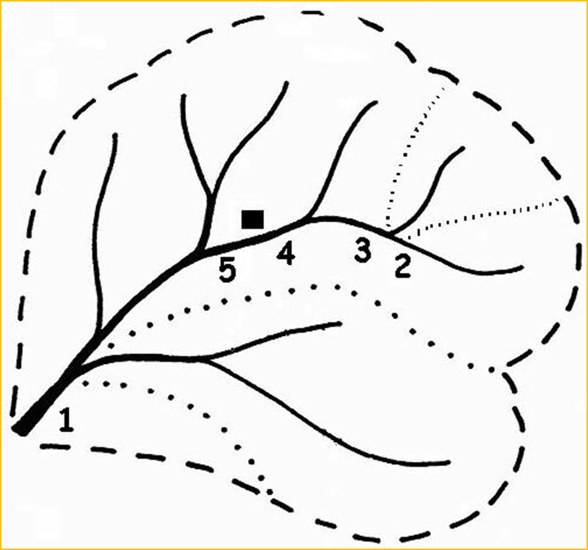
Site selection scenario
Sub-watershed
Point source
Sub-watershed
Watershed
Outlet
Notes:
(Hands-on Activity: Give students a few minutes to look at this picture in their notebook and determine the reasons for sampling each numbered location, and then give them the answers.)
To determine the impacts of a single tributary, select sites above and below the confluence of the tributary (Sites 2 & 3). Sampling at these sites would allow you to determine the impacts that may be occurring within the tributary’s watershed.
For point and non-point sources, you may want to monitor two sites, one above and bellow a source (point source, farm, etc.) The upstream site can be used as a reference to compare downstream data (Sites 4 & 5).
If you sampled at Site 1, you would determine the health of the entire watershed. The data would be a reflection of all influences upstream from this location.

Slide 15
Site location identification
Notes:
Next, we will discuss how to accurately identify the location of your site. This is a very important step, because without accurate site location information, your data will be meaningless and we won’t be able to use it! This is not difficult, but does require you to pay attention to details, so feel free to ask questions.

Slide 16
Site map
Map with site location marked and numbered is required for new site(s)
Processing will be delayed if map is not submitted
Notes:
When selecting a new site, you will need to include a copy of a map, with the new site clearly marked and labeled, along with your data. If we don’t receive a map for your site, there will be a delay in processing your data.
A map is only necessary the first time you have monitored at a new site.

Slide 17
Site LOCATION description
Always use the same verbal description
GPS coordinates are NOT a substitute!
Describe your site using:
Distance up or downstream of roadway crossings
Distance and direction from major intersections
Distance and direction from permanent landmarks
Example: 300 ft DS Hwy AA
Notes:
Use a verbal description that will enable staff to locate your site on a map.
It’s important to be consistent with this description, this can slow data processing.
Example: Gruener’s Ford, 100 feet upstream of Hwy P Bridge.
This could describe the downstream end of your 300-ft. site or it could describe where your riffle is located, or wherever within your site you choose to describe.
To help remember, consider filling out the header and then making copies of that Data Sheet.

Slide 18
Site numbering
Number sites chronologically
Site numbers are assigned to individuals, not Stream Teams
Site number for your location will never change
Your first site will always be your Site #1
Choosing Your Site
Factors to Consider
Location Identification
Data Sheet Headers
Notes:
Your monitoring sites are assigned to you as an individual monitor, and are numbered chronologically. Continue to use the same site number each time that you monitor at a site and submit data from that site. Remember, sites are NOT assigned to Stream Teams, they are assigned to individuals. Your site numbers will not necessarily be the same as the other people on your Stream Team! If you have questions about your Site numbers, just email or call us and we can get it straightened out.

Slide 19
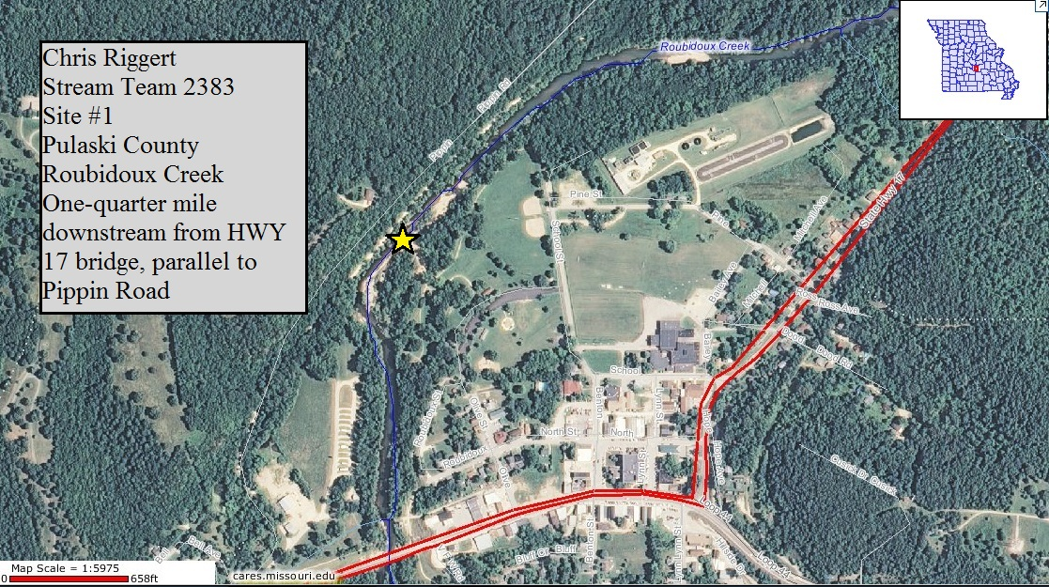
New site map
Roubidoux Creek
Pippin Road
Hwy 17
Notes:
This is an example of a map with the volunteer’s monitoring site marked on the map. The following information listed on the map will ensure that program staff are able to locate your site on the map.
Stream Team number
Name
County
Stream name
Site number
Verbal description: Please be consistent!

Slide 20
Where to find maps
Stream Team Interactive Map
DNR Interactive Map
Google Maps
Notes:
You can find maps to use on the Stream Team Interactive Map, the DNR Interactive Map called “Who’s Monitoring Your Watershed”, or just using Google Maps or Google Earth to locate your site.

Slide 21
Data Sheet Headers

Slide 22
Required info on all data sheets
Please fill out the header information on every data sheet
Data processing WILL be delayed if information is missing
Choosing Your Site
Factors to Consider
Location Identification
Data Sheet Headers
Notes:
All data sheets have this header. In this section, you identify the site number, stream name, county of the stream, and the verbal description of your site. This should always be the same on each sheet if it is for the same site number. Remember to be consistent with the site verbal description. Also in the header is the date you monitored in month, day, year format, the time of collecting the data in military time, rainfall in the last 7 days at that location. You won’t receive your thermometer until after you submit your Site Selection form, so you can leave the water temp field blank.
The trained data submitter is you, or the trained person assuming responsibility for this data. Trained data submitter is the person responsible for the data and site location. ATTENTION TEACHERS – kids are untrained participants and may not submit the data that they collect.
Participants are any other persons, trained or not, assisting with collecting the data.
Processing of data will be delayed if information is missing from your data sheets.

Slide 23
Weather/Rainfall information
Quick and easy way to get rainfall at your site: weatherunderground.com
Other Rainfall sources:
weather.com
noaa.gov
Local weather reports from newspapers, airports, radio or television stations
Use a rain gauge
Notes:
Using weather underground: type a location in the “Search Location” box. Scroll down until you see the “Almanac” section. Under the “Almanac section” look at the bottom of the “History” box (left most box under Almanac) and click the link for calendar of the month you are in and add up the actual precipitation values for the 7 days prior to your monitoring event. Each day has a listing of actual temperature and precipitation values along with average temperature and precipitation values.
Note: for some weather sites you may have to provide the zip code of the town closest to your sampling site. If possible, use the zip code of a town in the same watershed as the stream you are sampling.

Slide 24
Header (mis)information
What’s wrong with this data sheet?
4079
Litter Gitters
North County
Behind the Smith place by the big oak tree – 39˚ 27’ 56” 93˚ 53’ 47.5”
4/11
6:30
Trace
73
trace
73
Ms. Brown
?????
Fifteen 3rd grade class, was AWESOME!!
(What is this?)
Notes:
Ask the class what is wrong with the header on this data sheet:
Site #: This monitor probably does not have >4000 sites. This is probably their ST#
Stream: This is probably their ST name
County: North County is a local name and only means something if you’re from St. Louis. Be sure to use the actual county name where the site location is at.
Site Location: GPS coordinates cannot be used as a location description. The Smith Place and an oak tree cannot be located by using a map.
Date: Is this April 11th or April of 2011? Be sure to specify month, day, and year.
Time: Time is not in military format.
Water Temp: 73C is 163F! Unless this is being measured at a cooling water discharge, the measurement is incorrectly reported as F. Be sure to use C!
Trained Data Submitter: This information was likely filled out by a student. As the trained data submitter, “Ms. Brown” needs to be the one filling out the data sheet and her first and last name should be used.
Stream Team Number: If you forget your number, it is listed on your ST ID card or contact ST staff.
Trained Participants: It’s ok to write a class or group was participating. When possible, write out names so they can get credit if they are also VWQ monitors.

Slide 25
Importance of location ID
If we don’t know where your site is located, data will not be useful to the Program or others interested in your data
For all new sites, these three things must match:
Site number
Site location description
Mapped location
Notes:
It’s really important to get an accurate location description and map for your new sites. The most common mistakes that volunteers make on their verbal descriptions is getting confused on what is upstream and downstream, recording distances incorrectly or using the wrong units for the distance they measured (i.e. writing 300 yards when it is actually 300 feet), or not recording enough detail to locate their site.
The most common mistakes made on maps are not putting an X on their site location, printing a map that is impossible to read, or simply forgetting to include a map at all! Again, if you have questions about your site number, call or email us and we can check your sites for you.

Slide 26
Stream unnamed?
Intermittent Stream
Name too long
No official name
Geographic Names Information System (GNIS)
Use the name of the next named stream your stream flows into – “Tributary to …”
Notes:
Intermittent streams are shown on the topographic map as either a thin, solid, blue line, or a thin, solid blue line interrupted periodically with three little, blue dots.
Sometimes a stream is incorrectly identified as intermittent on the topographic map when it actually has some water in it year round.
Sometimes the stream name is too long to fit on the map, so it is left off.
And sometimes even though there is a local name for the stream, it has not been officially named by the USGS.
If you are monitoring on an unnamed stream, record it as a tributary to the next named stream that it flows into. For instance, “Tributary to Meramec River.”

Slide 27
How to get Your Site Added
Notes:
To enter data you will need to send a map to Streamteam@dnr.mo.gov.
Please submit your map after you have completed training.
The following will be helpful information to include on your map:
Your name
County
Site number if more than one site
Stream Name
Site description using permanent landmarks
If picking up a site on the interactive map include the Site IDX (DNR) number

Slide 28
Site selection Questions
How long is a monitoring site?
Which are important considerations for
site selection?
Are GPS coordinates OK for a good verbal
site location description?
What 3 things must match for accurate
site mapping into the database?
Notes:
Time for poll questions to review the chapter!
Poll will be displayed

Slide 29
Contact us
mostreamteam.org
Streamteam@dnr.mo.gov
Streamteam@mdc.mo.gov
youtube.com/@MissouriStreamTeam
facebook.com/mostreamteams/
800-781-1989
Notes:
Additional resources and training videos can be found online. Contact us if you have any questions.

