Slide 1
MAPPING AND ONLINE TOOLS
Notes:
Not we’re going to go over mapping and online tools. This is simply an opportunity to demonstrate helpful tools available to you online.

Slide 2
Objectives
Importance of Watershed Mapping
Topographic Maps
Online Tools
Notes:
Slide 2
When analyzing stream health, we take the holistic view of the entire watershed. For this, it’s important to understand watershed boundaries and locations of impacts to water quality. In this chapter, we will discuss watershed mapping, how to understand a topographic map, and the tools available to you online.

Slide 3
IMPORTANCE OF WATERSHED MAPPING
Notes:
Alright so lets jump into the importance of watershed mapping

Slide 4
Understanding watersheds
Essential to the interpretation of stream health and water quality
Everything that occurs within a watershed affects water resources
Stream health depends on a healthy watershed
Importance
Topographic Maps
Online Tools
Notes:
Slide 3
It’s essential to interpreting the stream health and water quality. Everything that occurs within a watershed affects the water resources. A healthy stream is an indicator of a healthy watershed.

Slide 5
Human uses of land and water impact water quality
Natural
Urbanized
Importance
Topographic Maps
Online Tools
Notes:
Slide 4
Natural environments have slower overland flow due to trees and plants. This allows for filtering of water before it enters the stream. This also results in a greater recharge of groundwater.
Compare that to an urbanized environment which has rapid overland flow, resulting in higher runoff. There is no filtering of the water before it enters the stream and has little or no groundwater recharge.

Slide 6
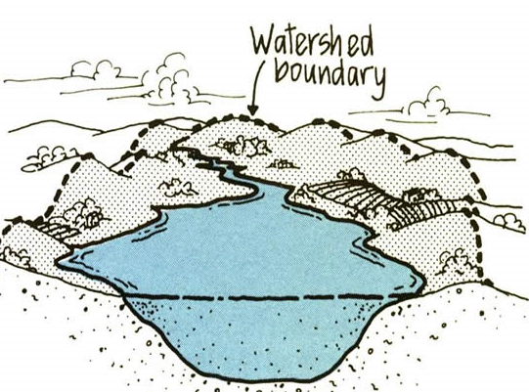
Think about Your watershed map
Choose a manageable size
Know your watershed boundaries as defined by topography
Land uses
Importance
Topographic Maps
Online Tools
Notes:
Slide 6
Mapping a watershed can have many benefits, including: Identifying sources of pollution, locating optimal monitoring sites, providing information to educate local community to make informed decision, and to provide a sense of value.
It is important to select an area that is of manageable size.
Your goal is to construct a map that will show watershed boundaries, topography and land use – to know your watershed thoroughly.
If you are working on a stream that has a large watershed, you may want to map a limited portion of the stream and watershed.
When selecting your area, you should also consider personal connections you may have to a particular watershed.
Understand that a watershed is defined by topography.
Identify land use in the watershed because it can impact your sampling results.

Slide 7
TOPOGRAPHIC MAPS

Slide 8
Topographic maps
Illustrate relief
Scale represents distance
Symbols show boundaries, surface features, buildings, roads, railroads, and communication features
Importance
Topographic Maps
Online Tools
Notes:
Slide 8
[Instructors NOT teaching should be prepped to hand out laminated topo maps of the Marble Hill quadrangle – 1 map for every 2-3 students.
Each map needs a moist paper towel, dry paper towel, dry erase markers.]
Topographic maps represent a specific area of land, or quadrangle -- a four-sided region bounded by a particular latitude and longitude.
Topo maps show the shape and elevation of features on the Earth’s surface using contour lines to illustrate relief.
Each topo map has a scale, representing distance. This is a ratio comparing a measurement on the map and the on-the-ground distance in real life.
Symbols show boundaries, surface features, buildings, roads, railroads and communication features.

Slide 9
Topo map symbology
Source: https://pubs.usgs.gov/gip/TopographicMapSymbols/topomapsymbols.pdf
Importance
Topographic Maps
Online Tools
Notes:
Slide 7
It’s important to understand the symbology and parts of a topo map. Here are some important symbols you will see on Missouri topo maps. For more symbols, you can visit the USGS website for the complete PDF.

Slide 10
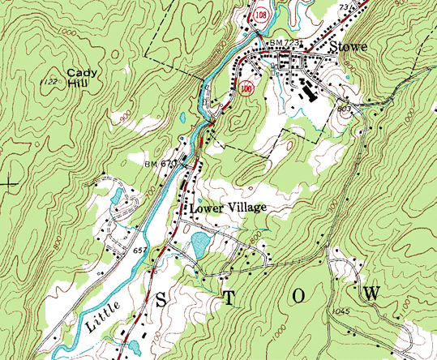
PARTS OF A TOPO MAP
Contour Lines
Importance
Topographic Maps
Online Tools
Notes:
Slide 10
Contour lines show the elevation. These lines will never cross. Notice that the contour index lines are marked with the elevation. You can find the elevation of the unmarked intermediate contour lines by using the contour interval printed in the margin.
When contour lines are close together, this indicates a steep terrain.

Slide 11
CONTOUR LINES
RULES OF V
Importance
Topographic Maps
Online Tools
Notes:
Slide 11
Contour lines can be demonstrated by using a hand and fist.
While making a fist, the parallel lines drawn around the fingers represent contour lines for different elevations.
The circle at the top represents a hill top or ridge top.
When the fist is opened and the hand laid flat, it resembles what you would see on a topo map.
The Rule of the “V”s:
The drawing on the lower left illustrates that when contour lines cross a river or stream they form a “V” shape that always points upstream.
This will help you determine the direction of flow.
This also applies to ridges.
On a topo map, ridge tops are shown as an enclosed shape, like an irregular oval.
As contour lines extend out from the hill or ridge top (going downhill), they often form rows of parallel “V”s.
When seen rippling outwards from a ridge top, the “V”s point downhill toward lower elevations, as seen in the drawing on the right.

Slide 12
PARTS OF A TOPO MAP
Contour Lines
Towns
Roads
Forest
Water
Importance
Topographic Maps
Online Tools
Notes:
Slide 12
Forests
Water Features
Towns
Roads

Slide 13
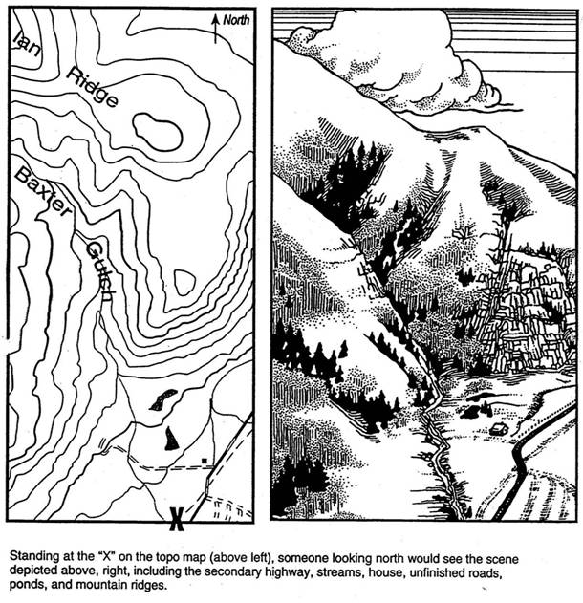
TRANSLATING THE TOPO MAP TO REAL LIFE
Importance
Topographic Maps
Online Tools
Notes:
Slide 13
If you were standing where the “X” was marked on the topo map and looked north, this is what you’d actually see.
Note locations of the house, Baxter Gulch, Ian Ridge, and the two hilltops on the map.
Now compare that with what you would actually see.

Slide 14
Drunken creek watershed
Steps for outlining a Watershed:
Mark stream and tribs in blue
Mark high points with an X
Connect Xs
Drunken Creek, Bollinger County US of Hwy U Bridge
Importance
Topographic Maps
Online Tools
Notes:
Slide 14
The most downstream point is already marked with an asterisk. The next step to map this watershed is to trace the main stem and its tributaries. Include intermittent stream segments, which are dashed lines on the topo map. Now, mark all ridge tops with an X. These will be the enclosed shapes. Finally, connect these Xs to outline the watershed.
Watershed mapping is not collected by the Program. It is for your benefit, to understand what areas drain into your stream and where potential impacts to water quality at your site may be.
[INSTRUCTORS] Use the laminated key to check the work of each group. Once the groups are complete, have them clean off the map before returning them to the map case.

Slide 15
Topo map Resources
Mo Stream Team Interactive Map
Base Map Gallery
USGS website
Mu Ag Assessment
Topo layer
Notes:
Here are some resources if you would like to look for a topo map for your site.

Slide 16
ONLINE WATERSHED MAPPING TOOLS
MU AG ASSESSMENT
MAP MY WATERSHED

Slide 17
Ag Site Assessment agsite.missouri.edu
Importance
Topographic Maps
Online Tools
Notes:
Slide 17
To map your watershed using the MU’s Ag site assessment you can enter your location, click on our desired location with click to center, and finally click generate report.

Slide 18
Ag Site Assessment agsite.missouri.edu
Report contains information like:
Site Summary
Local Demographics
Hydrologic Summary
Soils and Productivity
Environmental Concerns
Climate Summary
Importance
Topographic Maps
Online Tools
Notes:
Slide 18
The report pulls up great information about the area and you can generate maps from the report such as the watershed.
This is a great tool to figure out what’s could be contributing to your watershed and getting to know your area better.

Slide 19
How’s my waterway? www.epa.gov/waterdata/hows-my-waterway
Notes:
This is another online tool for mapping watersheds and also a good resources to learn about the conditions and uses of water in your local area.

Slide 20
How’s my Watershed
Notes:
Once you search your waterbody it will populate a map with the watershed so you can again take a look at the area that influences the water you are concerned with. You can also see the conditions of waters in the area and permitted discharge locations.

Slide 21
ONLINE TOOLS
Stream Team Interactive Map
USGS Water Data
Stream Team Website

Slide 22
Stream team website mostreamteam.org
Water Quality Resources
Order Equipment
Activity Report
Online Data Submission
Stream Team
Calendar
Interactive Map
Importance
Topographic Maps
Online Tools
Notes:
Slide 22
Back on the Stream Team website, there are many resources available to you. Under the Forms tab, you can submit Activity Reports, request equipment, and add new members to your Stream Team. The Water Quality Tab has the electronic files for much of what is provided to you at the workshops, helpful tips for monitoring, and information on upcoming workshops. If you’re looking for Teams to meet up with, take a look at the Stream Team Calendar to see larger events going on around the state. You can also submit your own events to be posted under this tab.

Slide 23
stream team interactive map mostreamteam.org/interactive-map.html
Stream Team adopted sites
VWQM sites
VWQM data
Streamteam@dnr.mo.gov
Importance
Topographic Maps
Online Tools
Notes:
Slide 23
Many resources can be found on the Stream Team website, including the Stream Team Interactive Map. This map can be used to find Stream Team adopted sites, VWQM sites, and corresponding VWQM data. If you use this map to find a site, note that not all locations are currently adopted or monitored. If you see a VWQM icon at the site you want to monitor, contact staff to see if it’s being currently monitored.

Slide 24
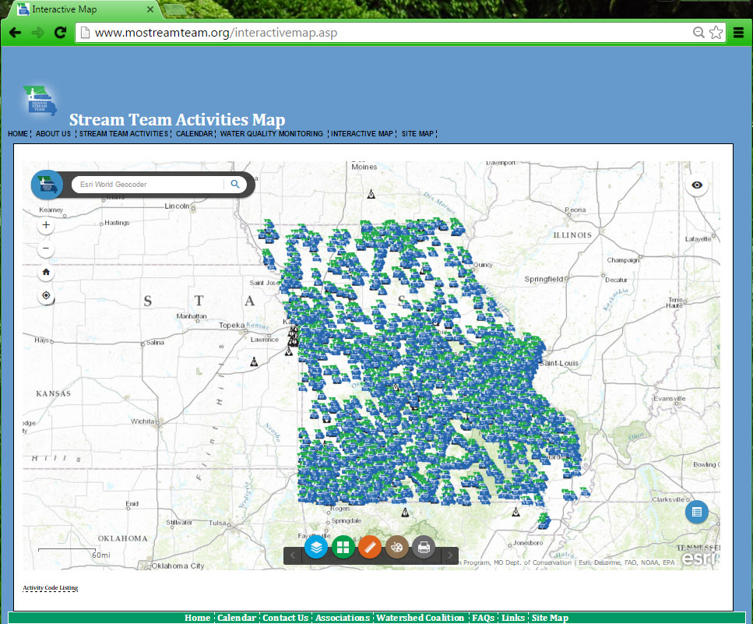
Notes:
Slide 24
(Home) When you enter the Interactive Map, this is the extent you will see. You will need to submit a map with your monitoring site marked each time you monitor a new location. We will show you how to map your new site using this map.

Slide 25
Notes:
Slide 25
(Search Bar) There are several different ways to find your site on the map. We will show you how to use the search bar to find the stream. Then, we will scroll and zoom to where we need to be. Begin by typing in the stream name. The search bar may suggest locations as you type, similar to a Google search. Here, we just needed to type “Roubidoux” and the second option to pop up is the Roubidoux Creek we want. Click on this option to select it.

Slide 26
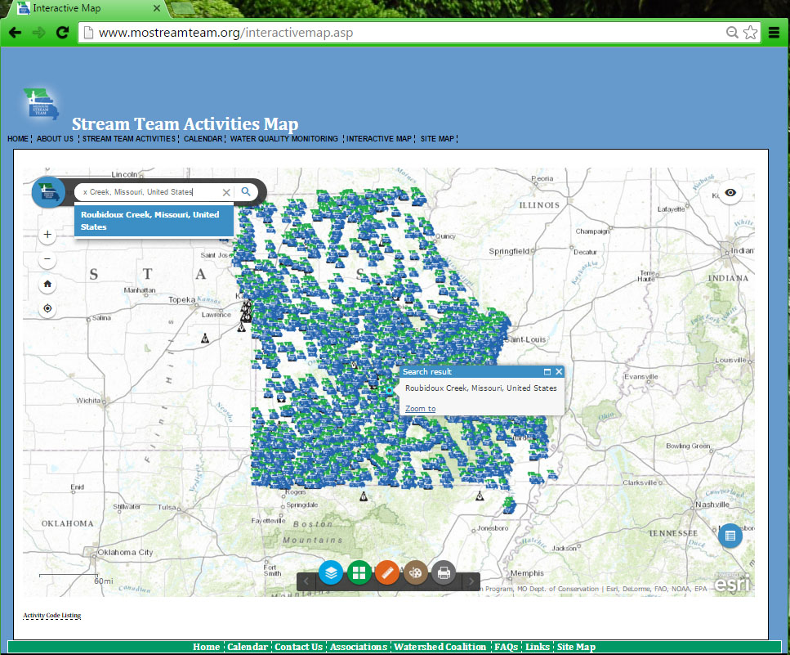
Importance
Topographic Maps
Online Tools
Notes:
Slide 26
(Zoom To) A popup box above the location will appear. Click Zoom To to zoom into Roubidoux Creek.

Slide 27
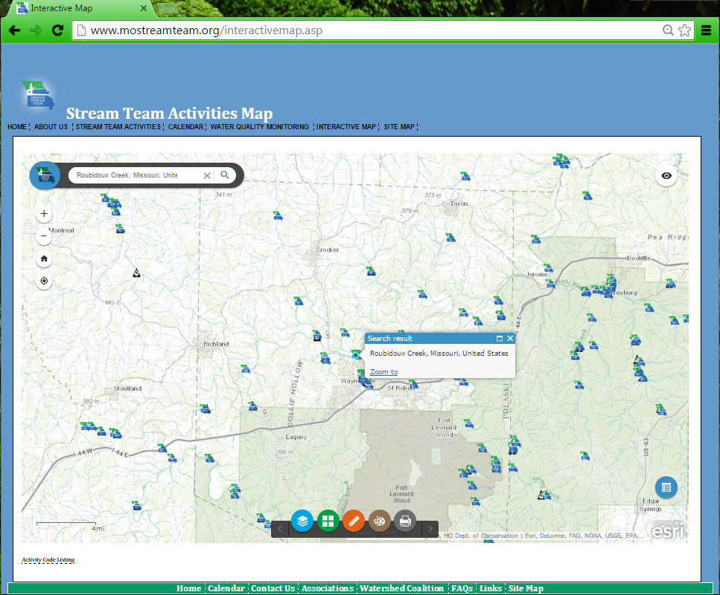
Notes:
Slide 27
(Zoomed To) The Zoom To option may not zoom into the extent of where you site is. Click on the map to drag it and “cruise” for your site. Zooming in or out may also help.

Slide 28
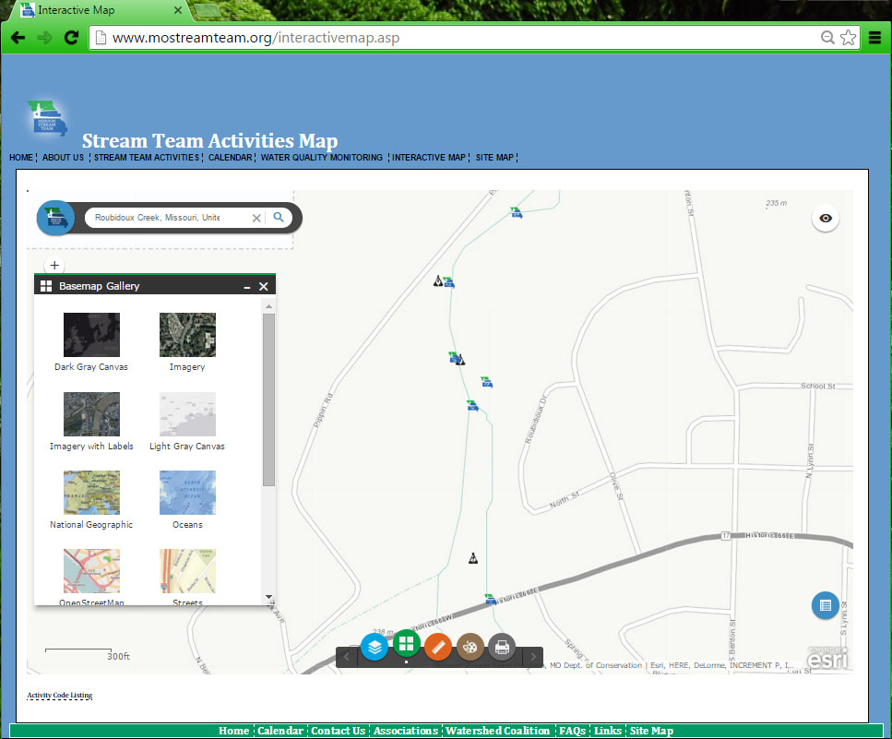
Notes:
Slide 28
(Base Map) You can change the base map to view a topographic map or satellite imagery for the area

Slide 29
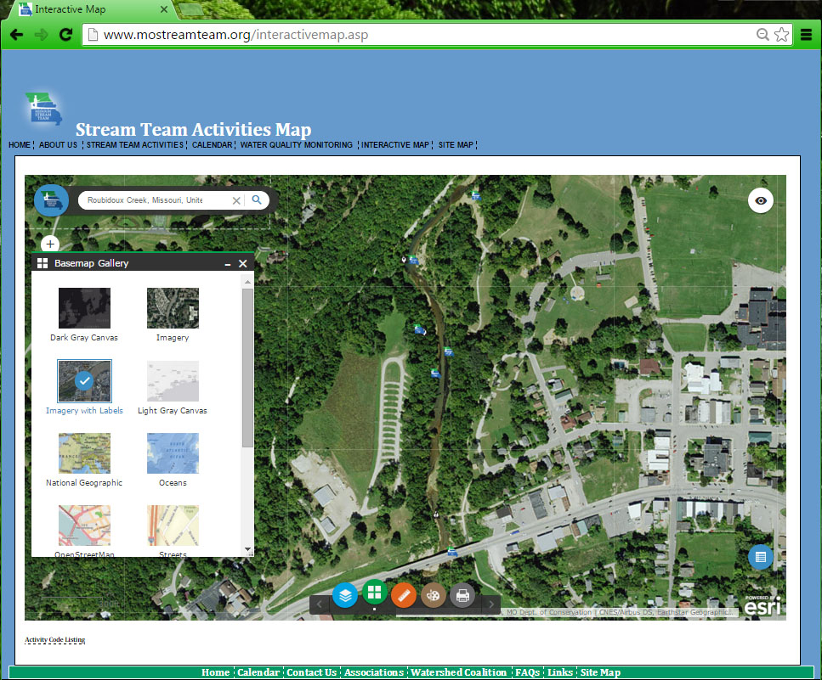
Notes:
Slide 29
(Imagery Base Map) Here we turned on the imagery base map to give us a better idea of what we are looking at. Our site is at the top of the map so we can drag the map down to center our location on the screen.

Slide 30
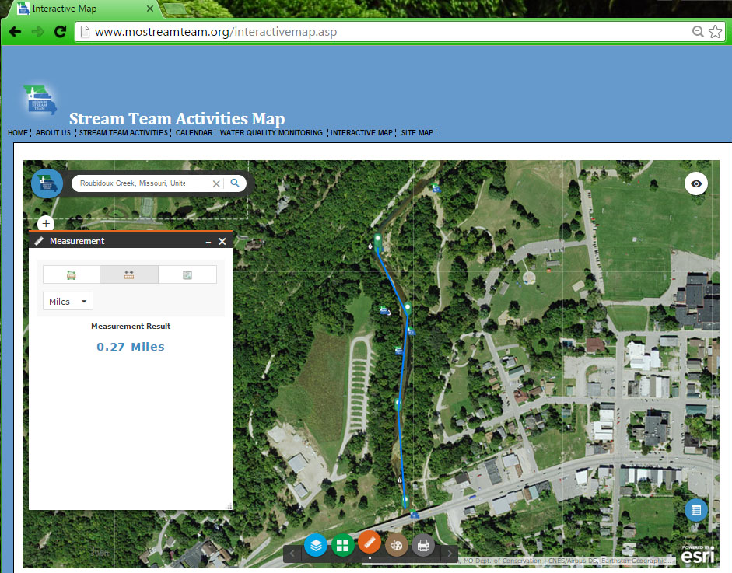
Notes:
Slide 30
(Measurement Tool) An accurate description of your site location is very important. The interactive map has a measurement tool that allows you to measure how many feet or miles you are from any given location, such as a bridge. You can also use this tool to map out 300 feet so you can visualize your full monitoring site.

Slide 31
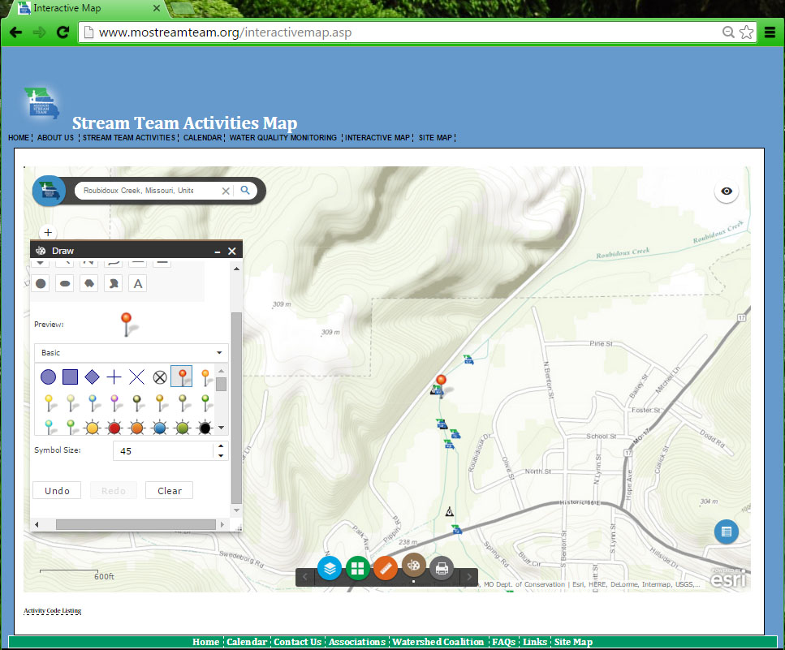
Notes:
Slide 31
(Draw Tool) From this point you can print your map and mark you site and add your information by hand. If you are comfortable using the map, this can all be done electronically before printing. By selecting the Draw Tool, you can add an icon to indicate your site location. Here, we selected a pin and increased the size so it was more visible.

Slide 32
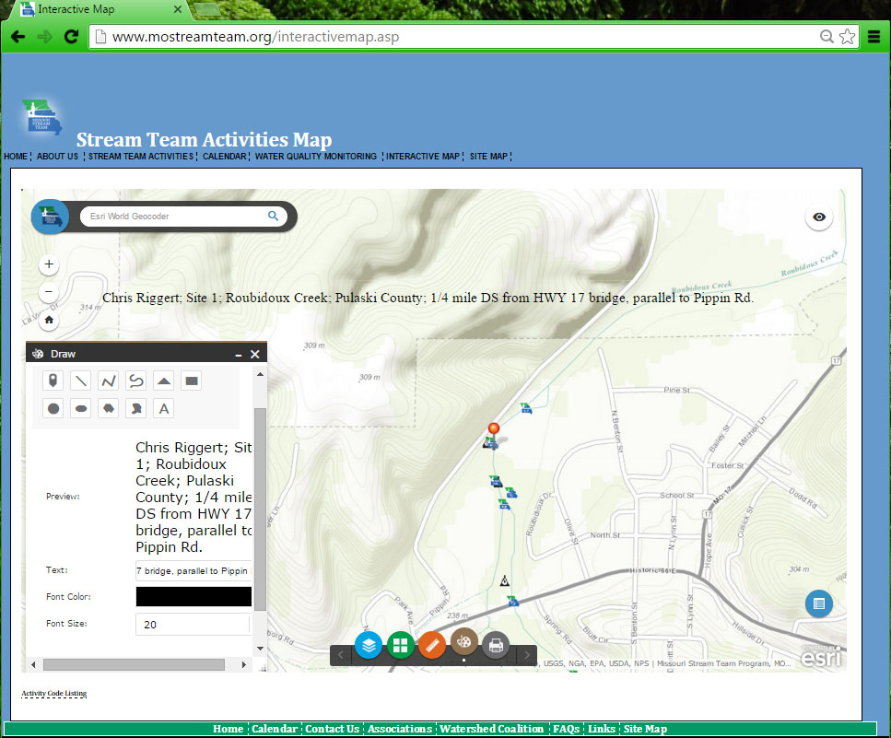
Notes:
Slide 32
(Draw Tool Description) Also using the Draw Tool, you can select the Text icon to write your location description to add to the map.

Slide 33
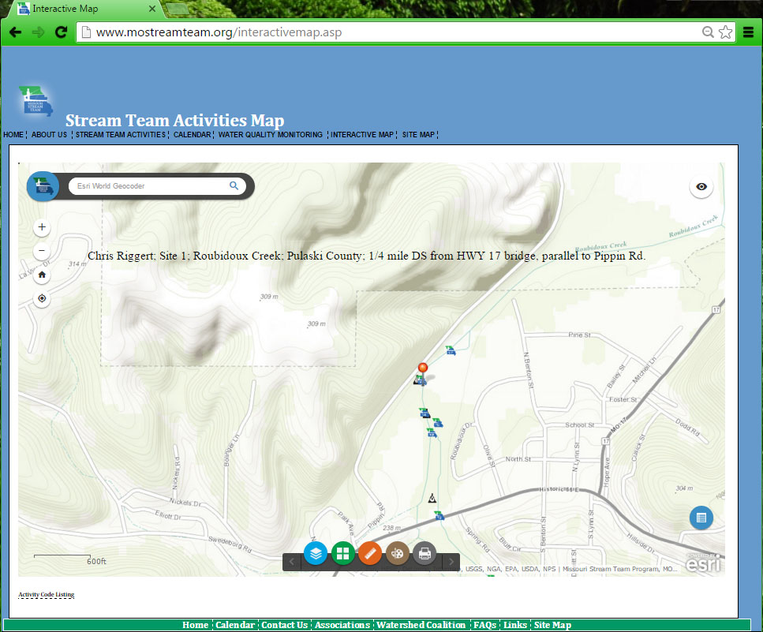
Notes:
Slide 33
(Final Map) Your map is now complete! Make sure the extent of your map shows all streets and features needed to locate your site.

Slide 34
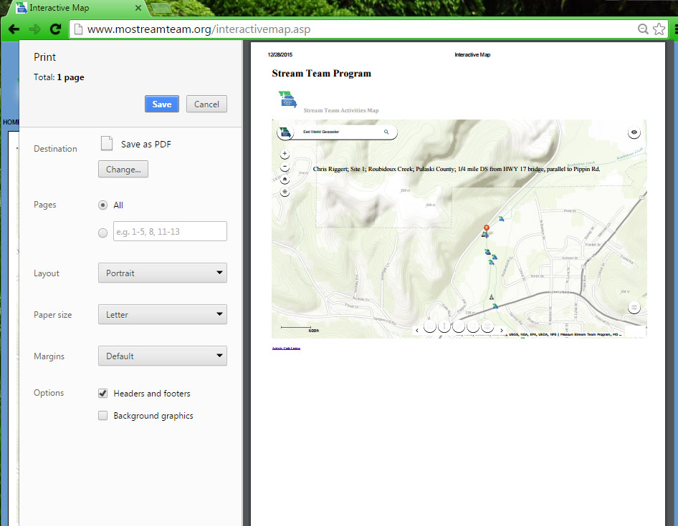
Notes:
Slide 34
(Print) There are a couple of ways to print your map. The easiest is to print from the web browser by pressing CTRL + P. This ensures the entire extent of your map will be shown on the page. You may also use the Print tool at the bottom of the map. If your location description is lengthy, this may not all fit on the print page.

Slide 35
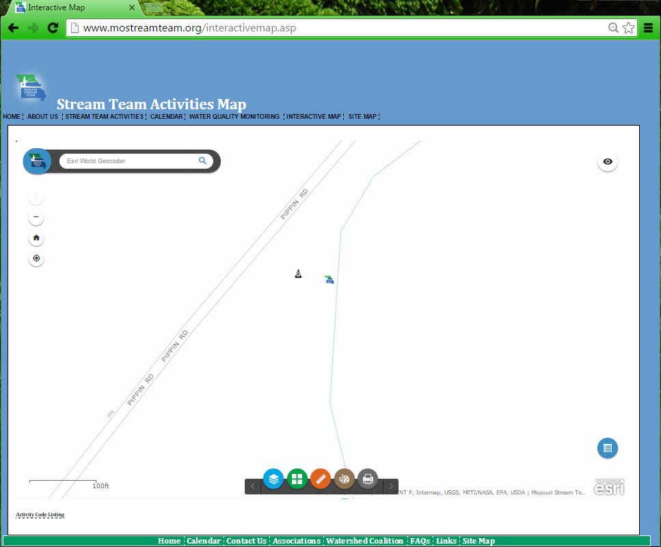
Notes:
Slide 35
(ST VWQM Icons) As mentioned earlier, there is lots of information you can pull from the interactive map. You will notice two different icons. The Stream Team logo indicates that location had an activity reported. The VWQM logo indicates the site has been monitored for water quality at some point in time.

Slide 36
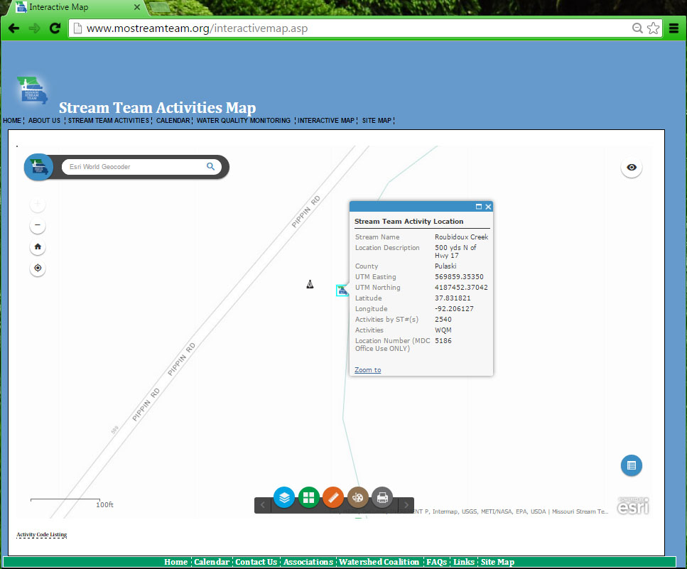
Notes:
Slide 36
(ST Icon) When you click on the Stream Team icon, you view what Stream Teams have reported at this site and what activities have been done. In this example, only WQM, or water quality monitoring, has been reported.

Slide 37
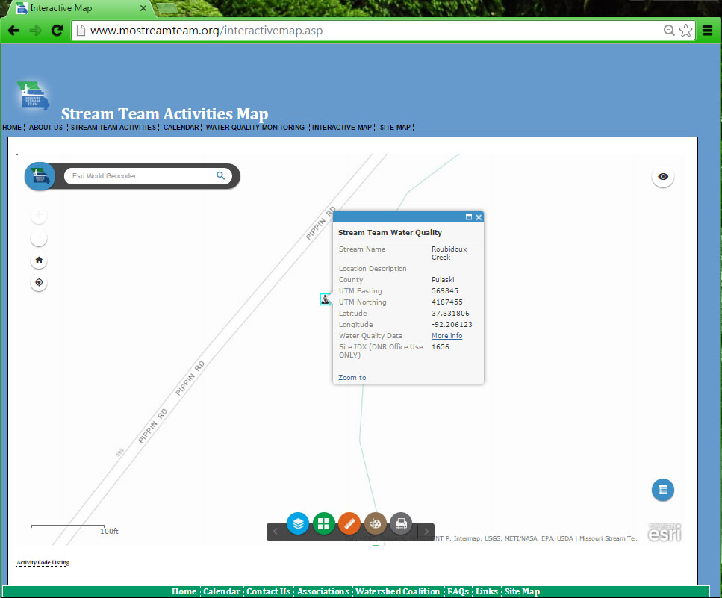
Notes:
Slide 37
(VWQM Icon) If you want to view water quality data, click on the VWQM icon. If you are adopting a site the easiest way to add volunteers to a site is to send staff a screen shot of the site showing the SITE IDX DNR number.
Here you will see a link for More Information. Click that link.

Slide 38
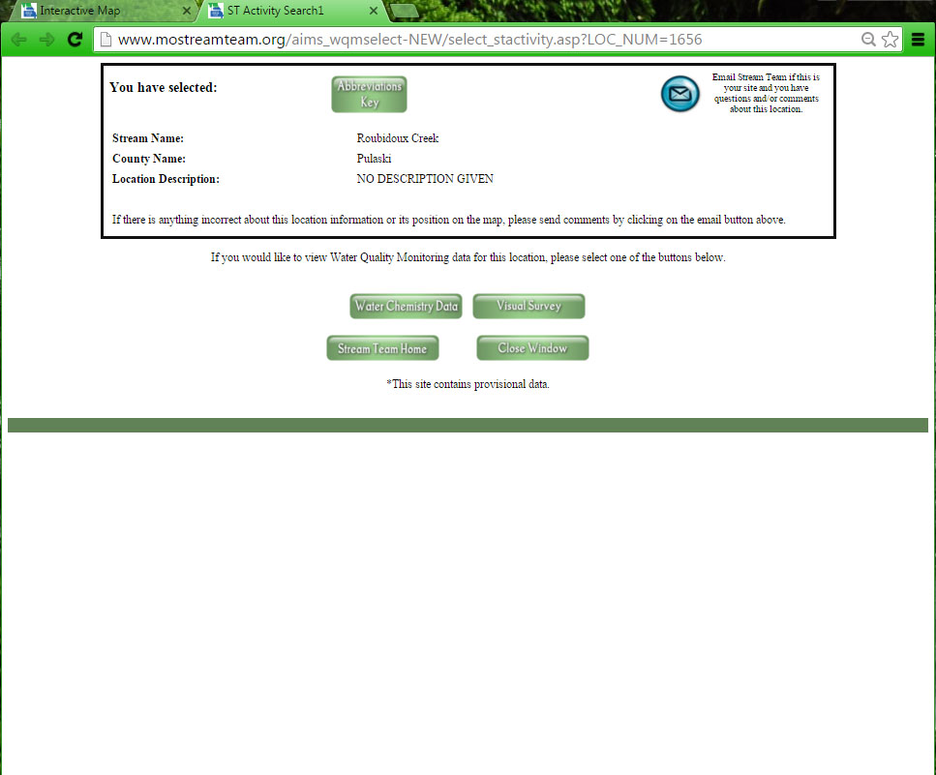
Notes:
Slide 38
*currently broken*
Must request data from DNR
If adopting a site, will need to reach out to DNR to see if this site is active or not.
(WQ Data) By clicking the More Information link to get water quality data, you will be taken to a new page. Click through to view any data reported.

Slide 39
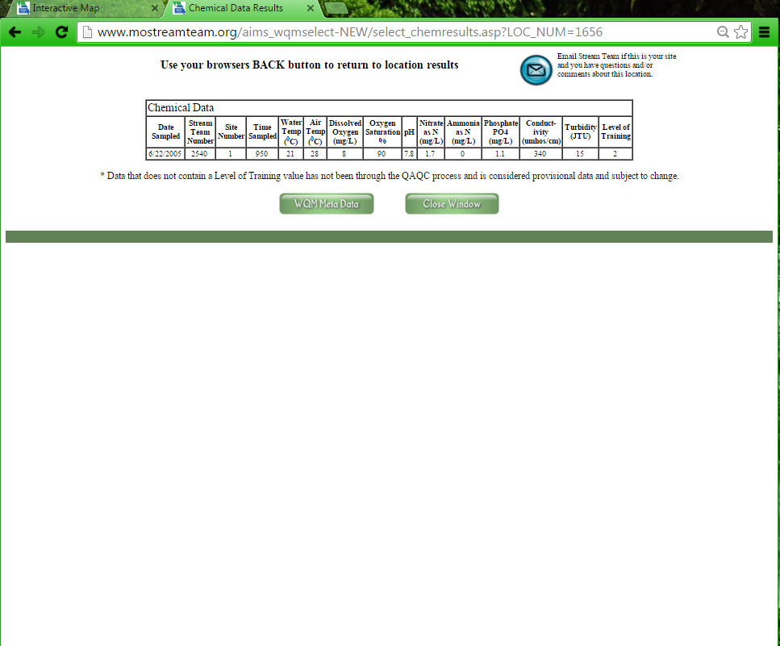
Notes:
Slide 39
(WQ Chem Data) We clicked on Chemistry Data. Only one set of data was reported; and that was back in 2005.

Slide 40
Adding your site!
A map is required to establish a new monitoring site
Maps will not be accepted until monitor completes field training
Send a map to: Streamteam@dnr.mo.gov
With the map please provide:
Your name
County
Site number for additional sites
Creek name
Site description using permanent landmarks
Site IDX (DNR) if adopting a site using the Stream Team Map
Importance
Topographic Maps
Online Tools
Notes:
Once you completed the field training and are certified as a Level 1 monitor, the next step is selecting a site. Data cannot be submitting online until this site is created under your user in the database. To establish your first monitoring site and subsequential sites, you will email a map of your site to streamteam@dnr.mo.gov. This map should include your name, stream name, county of the stream, and a verbal site description. If you are adopting an existing site from the Stream Team Interactive Map, also provide the Site IDX from the map information.
Do not submit a map or any data until field training is completed.

Slide 41
New Site Map
Importance
Topographic Maps
Online Tools
Notes:
Slide 41
Here is an example of a good site map, site indicated with a star, and the information required.

Slide 42
USGs water data waterdata.usgs.gov/mo/nwis/rt
Instantaneous Data:
Stream Discharge
Precipitation Values
Gage Height Values
Importance
Topographic Maps
Online Tools
Notes:
Slide 42
USGS is a recommended resource to use before venturing to your stream. This can ensure safe stream discharge for monitoring and reduce unexpected surprises.

Slide 43
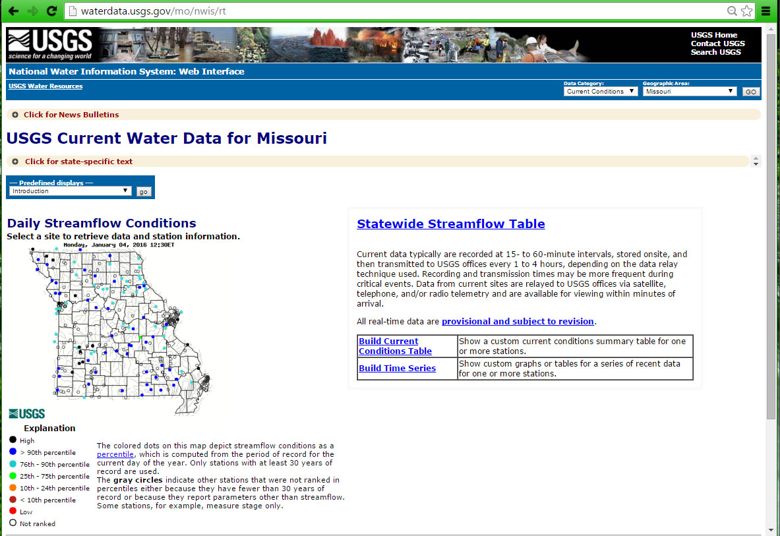
Importance
Topographic Maps
Online Tools
Notes:
Slide 43
(Home) USGS offers water data online, including stream discharge and precipitation. Not all streams have a USGS gauge and not all gauges measure all parameters. But, this is an excellent tool to evaluate general stream conditions before you head out to monitor. For instance, you may want to know if flood waters have begun receding after a flood event or you may want to see if stream discharge has increased with recent snow melt. From this home page for Missouri Water Data, you can click on a gauge on the map to view available data. By hovering over the points on the map, it will display the steam name and location of the gauge.

Slide 44
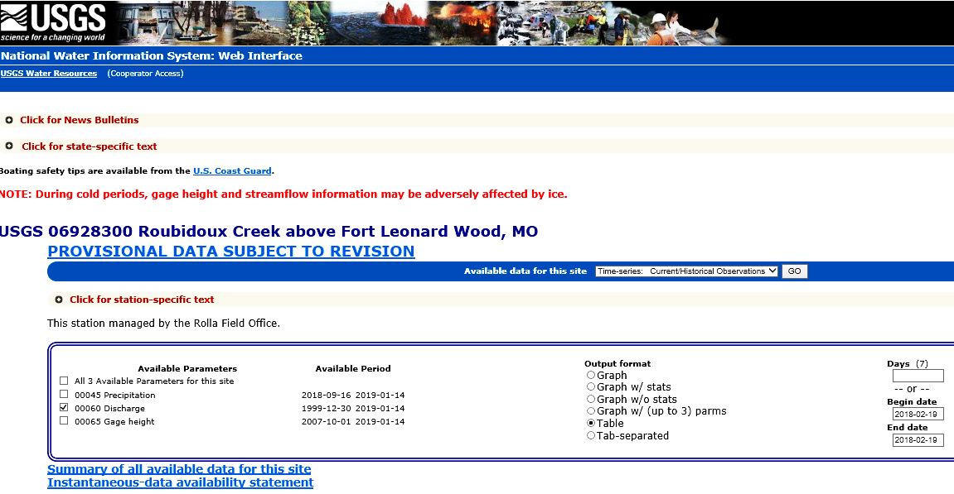
Importance
Topographic Maps
Online Tools
Notes:
Slide 44
(Gauge Data) By clicking on the point on the map, it will take you to a page displaying graphs of all the data available at that gauge. Common data to be displayed is gauge height, discharge, and precipitation. You can change the dates of the data and view a table format instead of the graph.

Slide 45
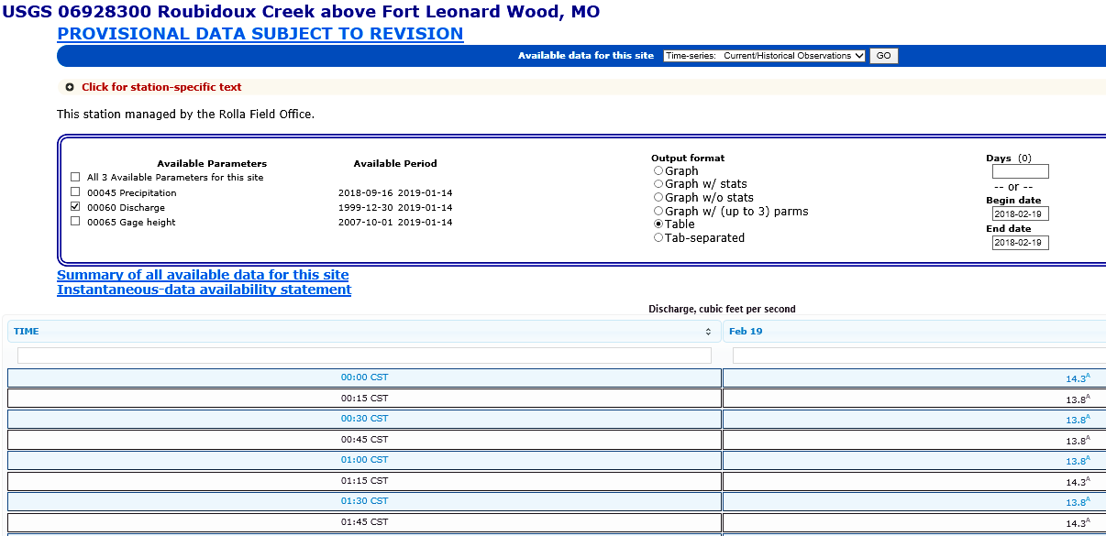
Importance
Topographic Maps
Online Tools
Notes:
Slide 45
(Discharge) Scroll down the page to view the available data, including the hydrograph. This is a very important tool to monitor river levels for your safety. As a reminder, The discharge data available on this site can be used to report on the Discharge Data Sheet only if the gauge is located on the same stream within one-half mile as your monitoring site, with no inputs or outputs between the gauge station and your site. If you report using this data, you must also report the gauge station number.

Slide 46
USGs water data
Reminder!
You may only use USGS discharge data to report on your VWQM Discharge Data Sheet if:
The USGS gaging station is within one-half mile of your VWQM monitoring sites
There are no inputs or outputs between the gaging station and your monitoring site
Importance
Topographic Maps
Online Tools
Notes:
Slide 46
In order for stream discharge data to be entered into the VWQM database, it needs to either 1) be the result of assessment using the VWQM program protocol, or 2) be from a USGS gage that is within a half-mile of the monitoring site with no additional inputs/outtakes between the volunteer’s site and the gage.

Slide 47
Activity Report
http://mostreamteam.org/
Select Activity Report
Request incentive items
Enter prize drawing
Help illustrate hours
Importance
Topographic Maps
Online Tools
Notes:
Please fill out one of these every time you conduct any Stream Team Activity. This allows us to track all the volunteer activities and time, and assign dollar values to these. There was over $3 million worth of effort in 2015 alone! This really helps to justify this Program, our time, travel, and all the materials we can provide to our dedicated volunteers.

Slide 48
Mapping Questions!
How are watershed boundaries defined?
What do contour lines indicate?
Where can you find the interactive map?
When can you use a USGS Gaging Station for stream discharge data for your monitoring site?
Notes:
Poll
Here’s some review questions for you:
How are watershed boundaries defined?: they’re defined by the highest elevation points surrounding a specific drainage area.
What do contour lines indicate?: the indicate elevation changes, or relief
Where can you find the interactive map?: on the ST website
When can you use a USGS gaging station for stream discharge data for your monitoring site?: .5mi from your site and no inputs or outputs.

Slide 49
Contact us
mostreamteam.org
Streamteam@dnr.mo.gov
Streamteam@mdc.mo.gov
youtube.com/@MissouriStreamTeam
facebook.com/mostreamteams/
800-781-1989
Notes:
Additional resources and training videos can be found online. Contact us if you have any questions.

